Slide 1
In-Fiber Network

Slide 2
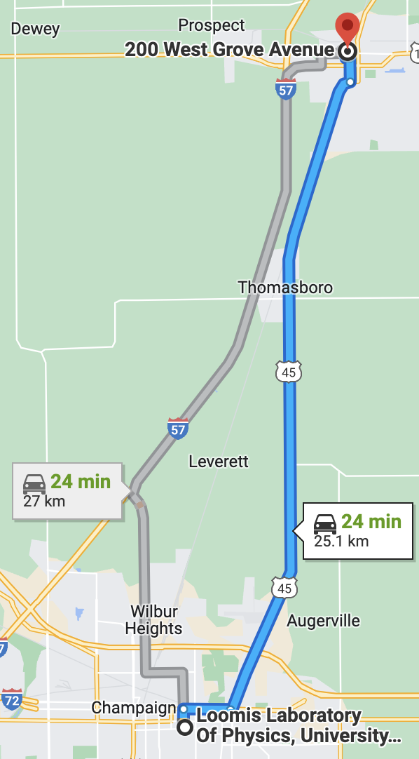
Urbana-Chicago Fiber Link
Fiber Loop from UIUC→Rantoul→UIUC
52.6-km roundtrip fiber
~18.5-dB loss at 1550nm

Slide 3
Polarization Stability
Send different wavelengths utilizing tunable laser
1549-1550nm
Measure the polarization after sending light of different wavelengths through the loop over multiple hours

Slide 4
Polarization Stability

Slide 5
Polarization Stability
Single polarization correction not viable for different wavelengths

Slide 6
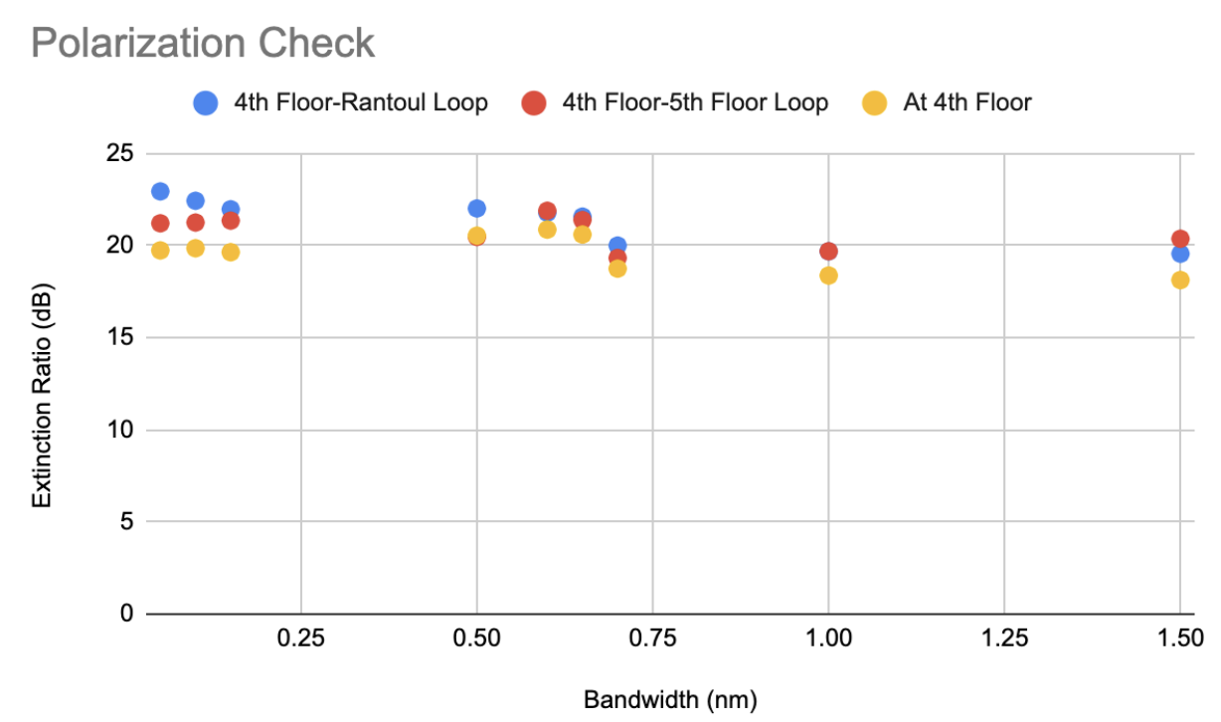
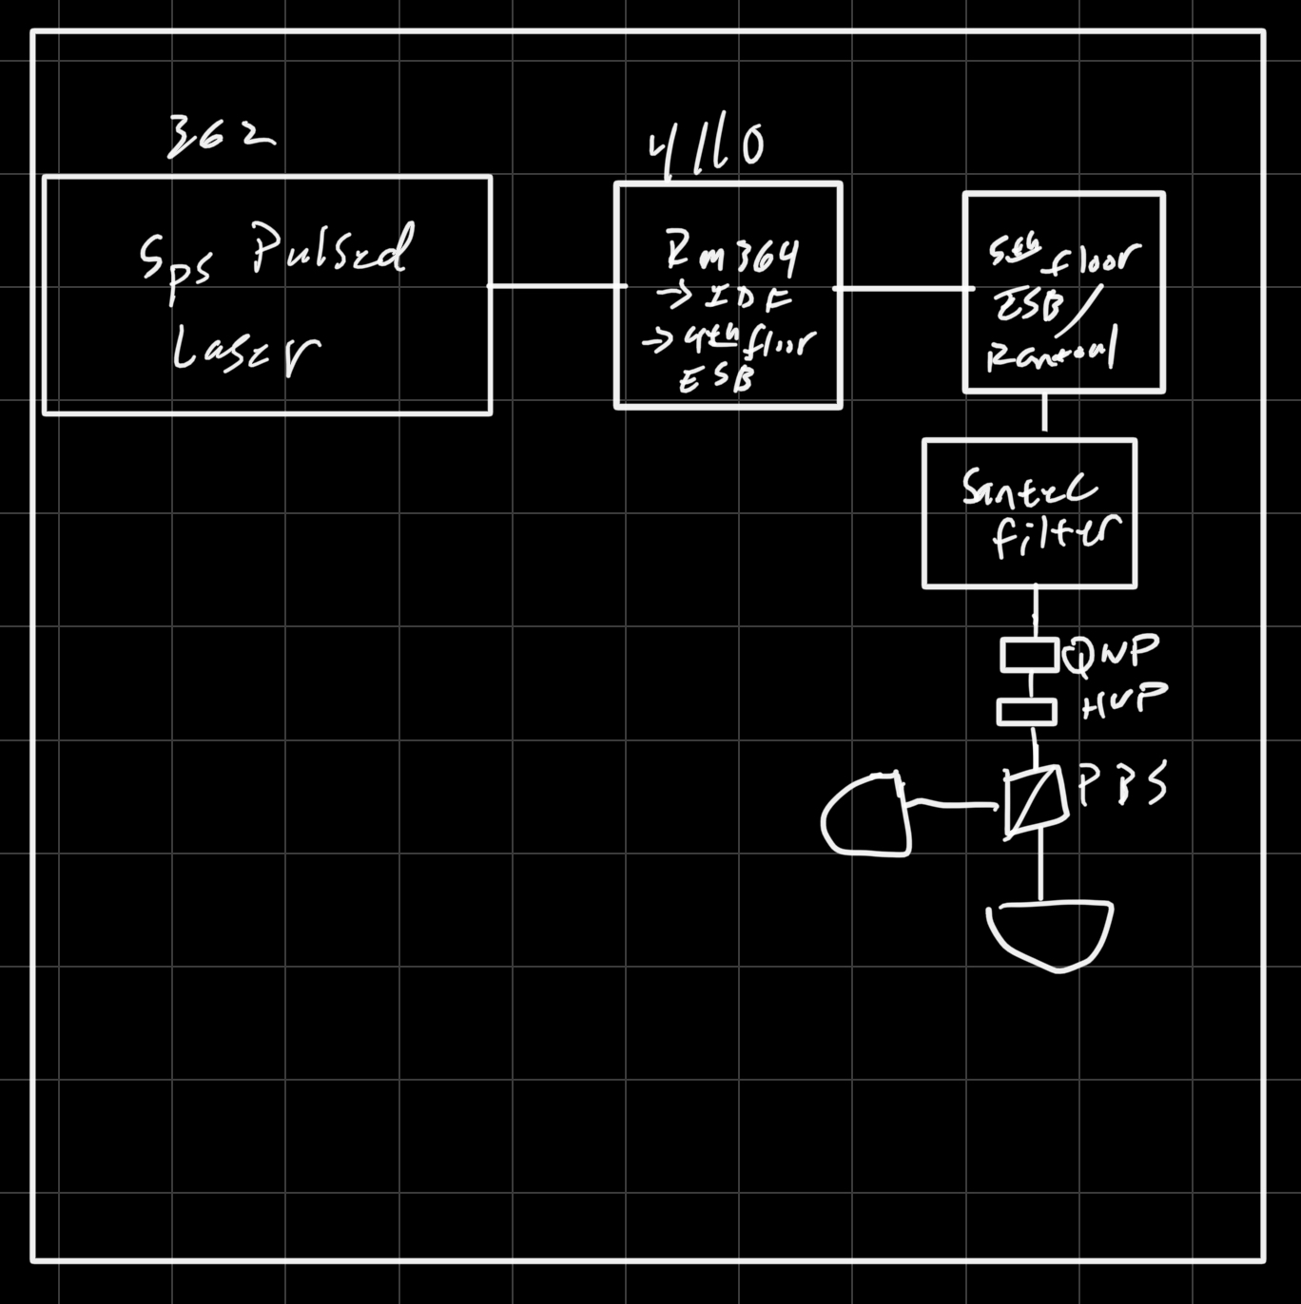
Polarization Check Method 2

Slide 7
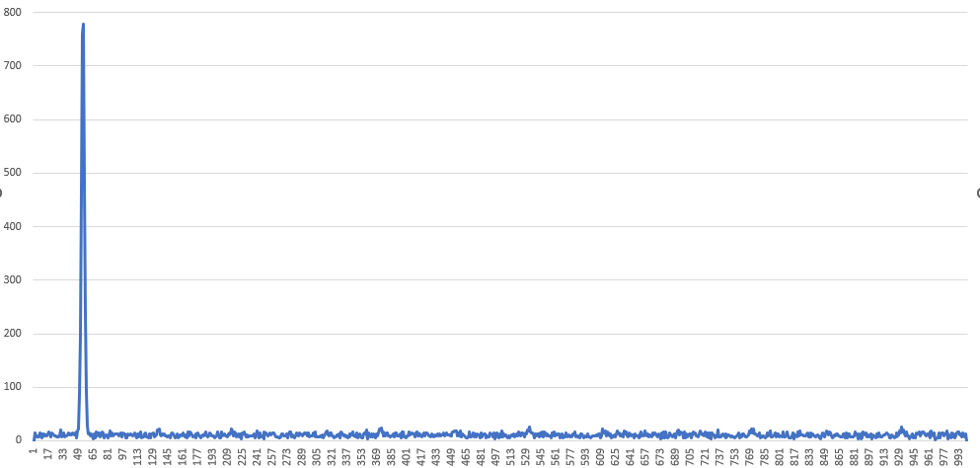
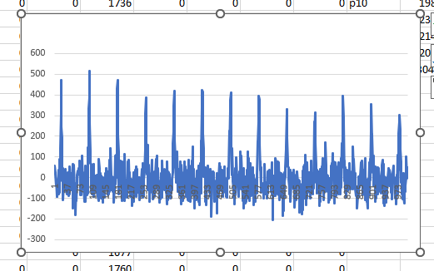


Photon Pair Source
Pump with Tsunami (80 Mhz, 775nm, 100fs )+pulse shaper (With grating+single model fiber as small slit), the shaped pulse is around 0.65nm bandwidth at 1550, but not Fourier transform limited.
The photon are detected with InGaAs detection, with <10% efficacy and 40K/4K dark counts rate
F2=200 mm
HWP
QWP
F1=150 mm
Tsunami
Pulse
shaper
Dichroic
LP filter
Aspheric lens/coupling stage
DHWP
F2=200 mm
Cross g2: $=65±1.2$
DPBS
LP filter
PPTKP
Aspheric lens/coupling stage
Focusing and collimating lens
Signal beam waist 2.5mm
F=15.29mm
Auto g2: $=\text{1.3048}±0.08$
Signal beam waist 39um
Pump beam waist 25um
F1=150 mm
F2=200 mm

Slide 8
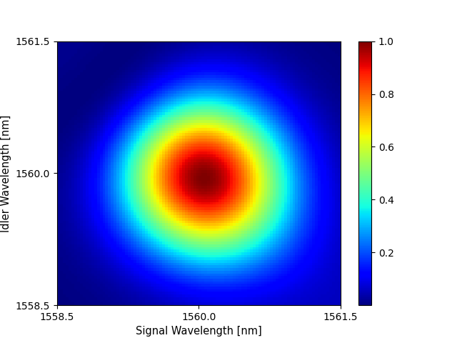
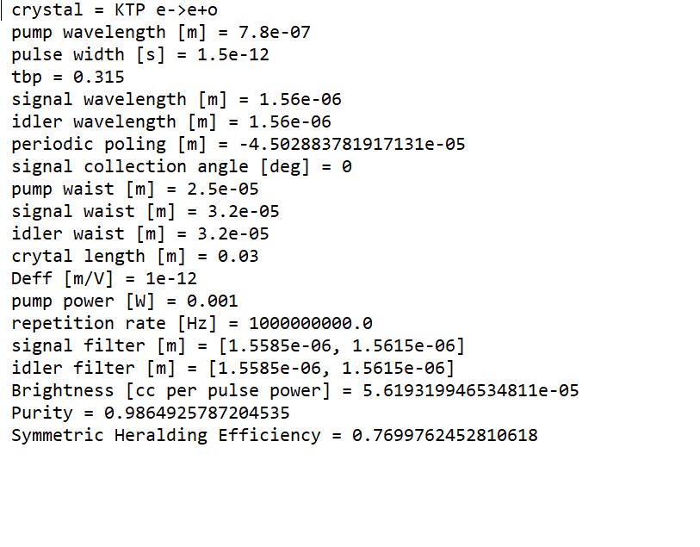
Photon Pair Source
Expected purity with 1.5ps pump

Slide 9
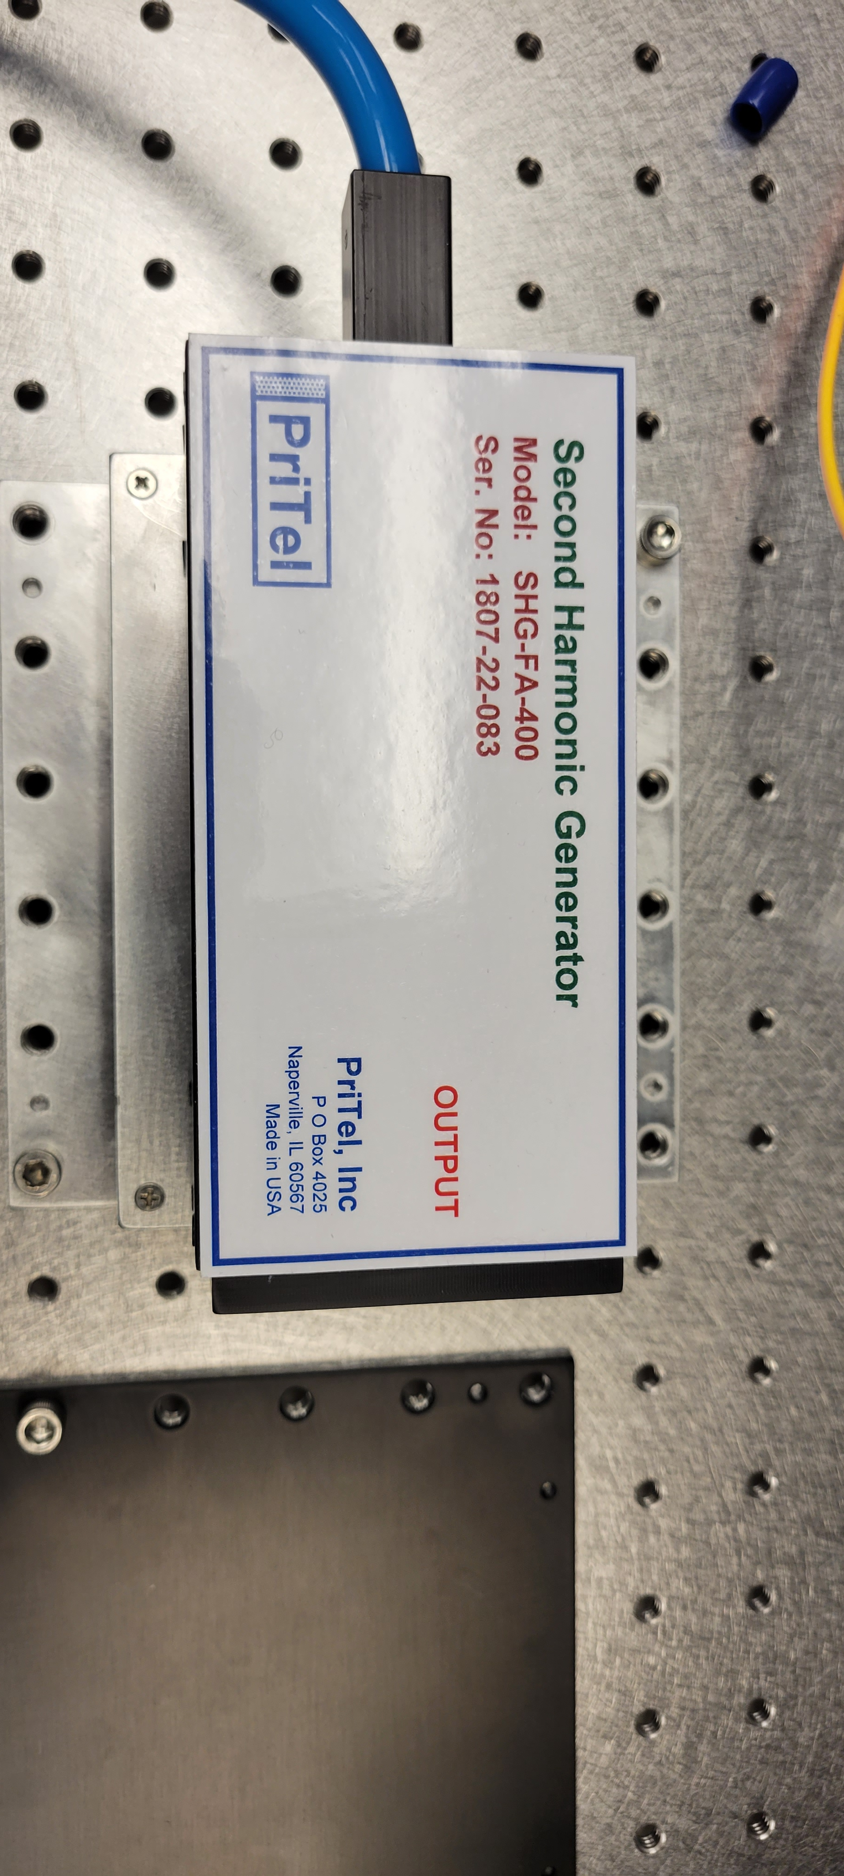
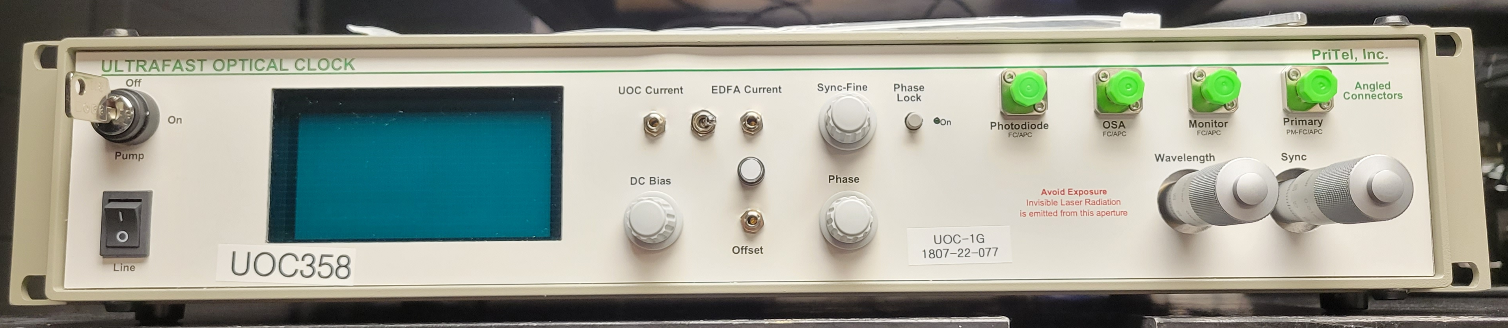
Pritel Laser
Mode Locked fiber laser in telecom (tunable around 1550nm)
Tunable rep rate up to 10.017GHz
Pulse-widths from 1.3-6.5ps
SHG also provided with laser
Possibly use the laser/SHG to pump the single photon source instead of current setup

Slide 10
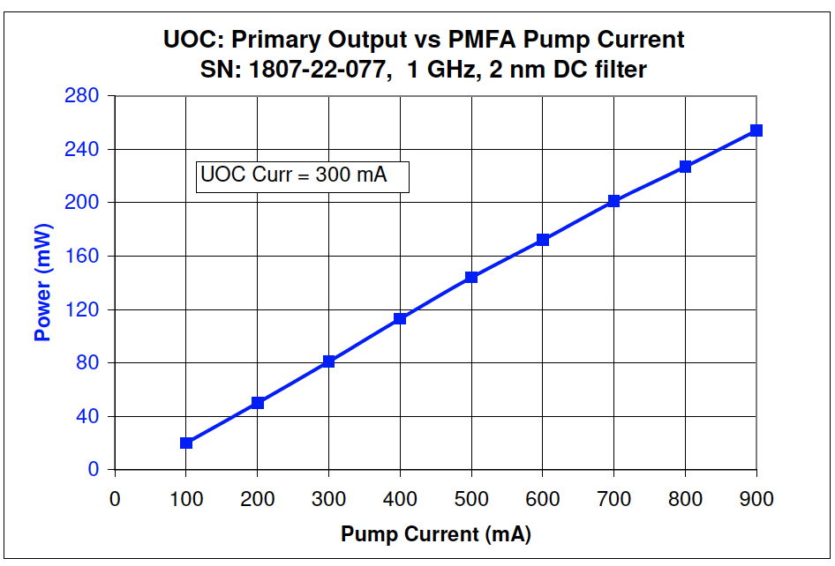
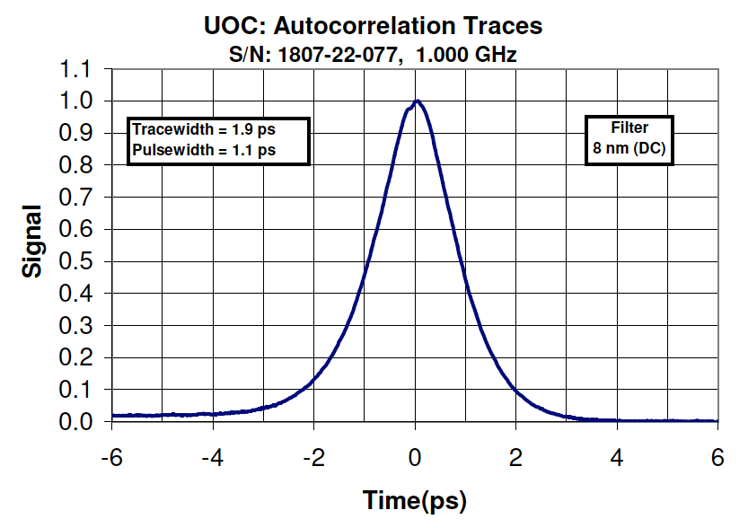

Slide 11
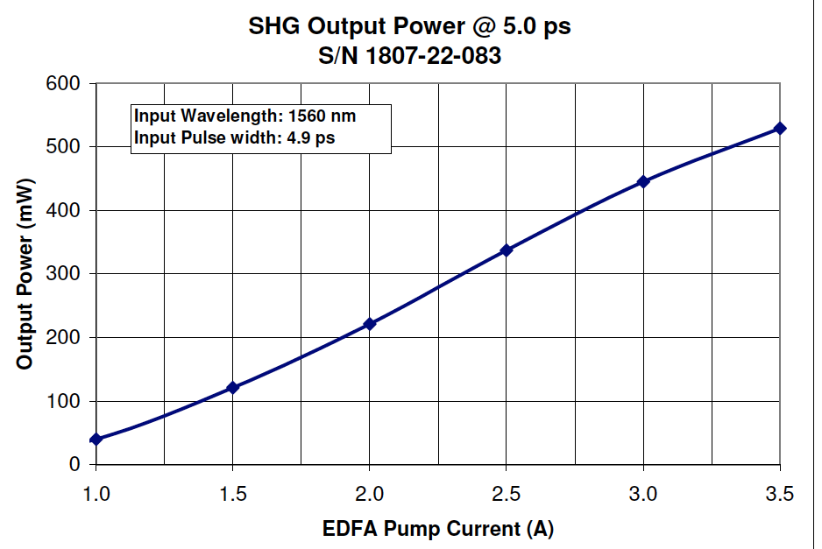
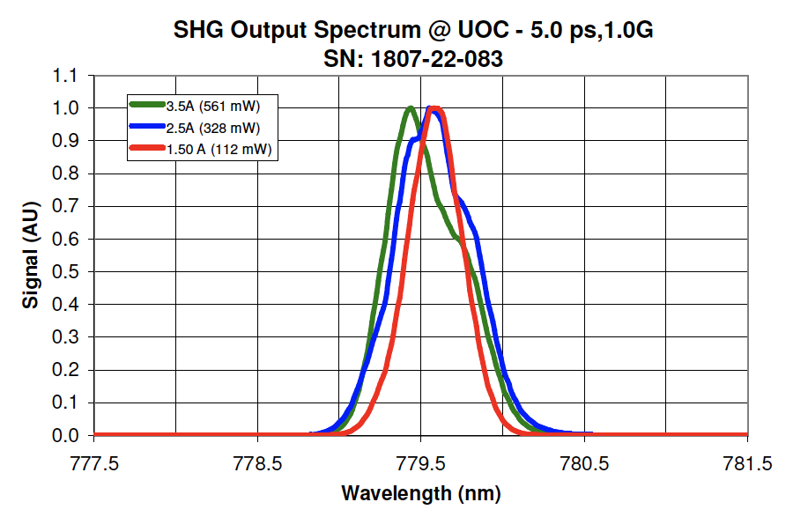
Pritel SHG

Slide 12
PPS Future Measurements
Colin’s SNSPD
F2=200 mm
HWP
QWP
F1=150 mm
Pritel
SHG
Dichroic
LP filter
Aspheric lens/coupling stage
Pump with Pritel laser (1560nm, tunable pulse duration)
The photon can be collected and sent to Colin’s SNSPD for a g⁽²⁾ measurement.
There are currently 12 links between two labs
DHWP
F2=200 mm
DPBS
LP filter
PPTKP
Aspheric lens/coupling stage
Focusing and collimating lens
Pump beam waist 1.5mm
Signal beam waist 2.5mm
F=15.29mm
Signal beam waist 39um
Pump beam waist 25um
F1=150 mm
F2=200 mm

